Slide 1
Predicting Micro Credit Loan Defaulters
Submitted by-:
Manoj Kumar Saxena

Slide 2
Content
Problem Description
Data pre-processing
EDA
Data cleaning
Model Deployment
Hyper Parameter Tuning
Conclusion

Slide 3
Problem Description & Understanding of Data

Slide 4
Problem Description
A Microfinance Institution (MFI) is an organization that offers financial services to low income populations. MFS becomes very useful when targeting especially the unbanked poor families living in remote areas with not much sources of income. The Microfinance services (MFS) provided by MFI are Group Loans, Agricultural Loans, Individual Business Loans and so on.
Many microfinance institutions (MFI), experts and donors are supporting the idea of using mobile financial services (MFS) which they feel are more convenient and efficient, and cost saving, than the traditional high-touch model used since long for the purpose of delivering microfinance services. Though, the MFI industry is primarily focusing on low income families and are very useful in such areas, the implementation of MFS has been uneven with both significant challenges and successes.
Today, microfinance is widely accepted as a poverty-reduction tool, representing $70 billion in outstanding loans and a global outreach of 200 million clients.
We are working with one such client that is in Telecom Industry. They are a fixed wireless telecommunications network provider. They have launched various products and have developed its business and organization based on the budget operator model, offering better products at Lower Prices to all value conscious customers through a strategy of disruptive innovation that focuses on the subscriber.
They understand the importance of communication and how it affects a person’s life, thus, focusing on providing their services and products to low income families and poor customers that can help them in the need of hour.
They are collaborating with an MFI to provide micro-credit on mobile balances to be paid back in 5 days. The Consumer is believed to be defaulter if he deviates from the path of paying back the loaned amount within the time duration of 5 days. For the loan amount of 5 (in Indonesian Rupiah), payback amount should be 6 (in Indonesian Rupiah), while, for the loan amount of 10 (in Indonesian Rupiah), the payback amount should be 12 (in Indonesian Rupiah).
The sample data is provided to us from our client database. It is hereby given to you for this exercise. In order to improve the selection of customers for the credit, the client wants some predictions that could help them in further investment and improvement in selection of customers.

Slide 5
Column Description:
label: Flag indicating whether the user paid back the credit amount within 5 days of issuing the loan
msisdn: mobile number of user
aon: age on cellular network in days
daily_decr30::Daily amount spent from main account, averaged over last 30 days (in Indonesian Rupiah)
daily_decr90::Daily amount spent from main account, averaged over last 90 days (in Indonesian Rupiah)
rental30:Average main account balance over last 30 days
rental90:Average main account balance over last 90 days
last_rech_date_ma: Number of days till last recharge of main account
last_rech_date_da : Number of days till last recharge of data account
last_rech_amt_ma : Amount of last recharge of main account (in Indonesian Rupiah)
cnt_ma_rech30: Number of times main account got recharged in last 30 days
fr_ma_rech30: Frequency of main account recharged in last 30 days
sumamnt_ma_rech30: Total amount of recharge in main account over last 30 days (in Indonesian Rupiah)
medianamnt_ma_rech30: Median of amount of recharges done in main account over last 30 days at user level (in Indonesian Rupiah)
medianmarechprebal30:Median of main account balance just before recharge in last 30 days at user level (in Indonesian Rupiah)
cnt_ma_rech90:Number of times main account got recharged in last 90 days
fr_ma_rech90:Frequency of main account recharged in last 90 days
sumamnt_ma_rech90:Total amount of recharge in main account over last 90 days (in Indonesian Rupiah)

Slide 6
medianamnt_ma_rech90:Median of amount of recharges done in main account over last 90 days at user level (in Indonesian Rupiah)
medianmarechprebal90:Median of main account balance just before recharge in last 90 days at user level (in Indonesian Rupiah)
cnt_da_rech30:Number of times data account got recharged in last 30 days
fr_da_rech30:Frequency of data account recharged in last 30 days
cnt_da_rech90:Number of times data account got recharged in last 90 days
fr_da_rech90:Frequency of data account recharged in last 90 days
cnt_loans30: Number of loans taken by user in last 30 days.
amnt_loans30:Total amount of loans taken by user in last 30 days
maxamnt_loans30:maximum amount of loan taken by the user in last 30 days
medianamnt_loans30:Median of amounts of loan taken by the user in last 30 days
cnt_loans90:Number of loans taken by user in last 90 days
amnt_loans90:Total amount of loans taken by user in last 90 days
maxamnt_loans90:maximum amount of loan taken by the user in last 90 days
medianamnt_loans90:Median of amounts of loan taken by the user in last 90 days
payback30:Average payback time in days over last 30 days
payback90:Average payback time in days over last 90 days
pcircle: telecom circle
pdate: date

Slide 7
Data Summary
Data has no-null values.
Data set has 209592 no. of records and 36 columns.
Data has three object type attribute while others are integer or float.
Object type attribute are:
Msiddn: The cellular networks no.
Pdate: the date
Pcircle: Circle of the credit card user.

Slide 8
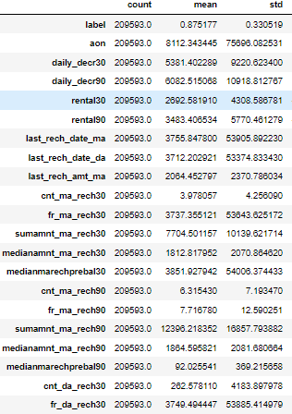
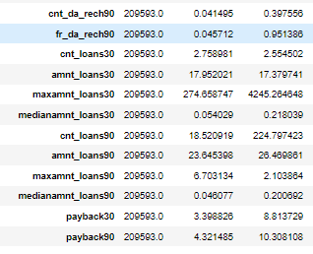
All columns has standard deviation greater than mean of their attributes.

Slide 9
Observation on Data description.
As we can see that there is high variance in mostly all columns i.e. std > mean in mostly all columns.
in aon there should be no negative values as days shouldn't be negative and max values for this are too high A user should use max for 10 years.
In daily_decr30&90 : in this the amount spent shouldn't be negative removing such values too.
last_rech_date_ma& last_rech_date_da in this the days shouldn't be negative. and max values should be 3600.
fr_ma_rech30,cnt_da_rech30,fr_da_rech30,maxamnt_loans30,cnt_loans90,medianmarechprebal30: max values is seems to be inappropriate of these columns.

Slide 10
Exploratory Data Analysis (EDA)

Slide 11
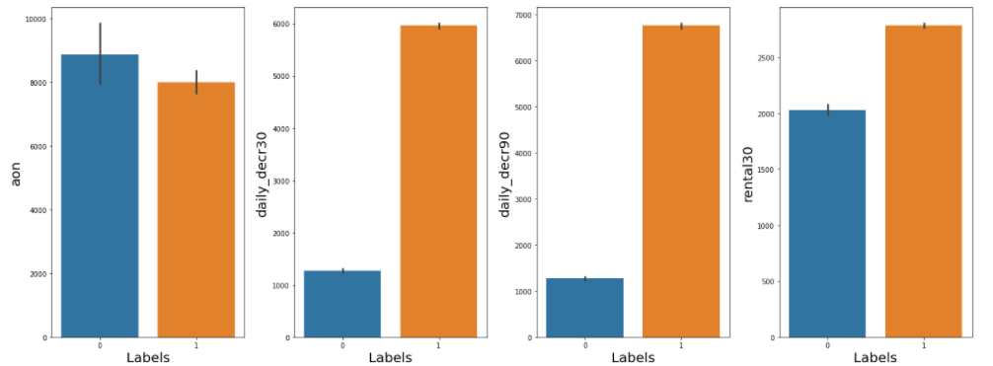
Maximum Users who paid bill having aon values has maximum 8000 age on its cellular networks.
Daily amount spent from main account, averaged over last 30/90 days (in Indonesian Rupiah) who are maximum defaulter are in range of 1000 to 1200.
Average main account balance over last 30 days are having maximum 2000 are the maximum no. of defaulters

Slide 12
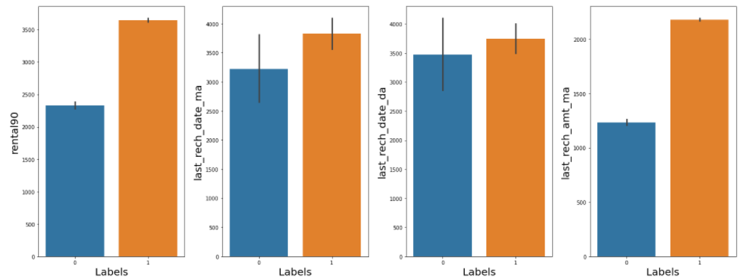
over 90 days the maximum defaulter having maximum main account balance in range of 2000-2500 .
Number of days till last recharge of main account for defaulter having max in range off 3700 to 3800 while for data account we didn't get much info we plot more graphs for data account.
Defaulter has done maximum last recharge for main account (in Indonesian Rupiah) is in range of 1200-1300 while other users done more than 2500.

Slide 13
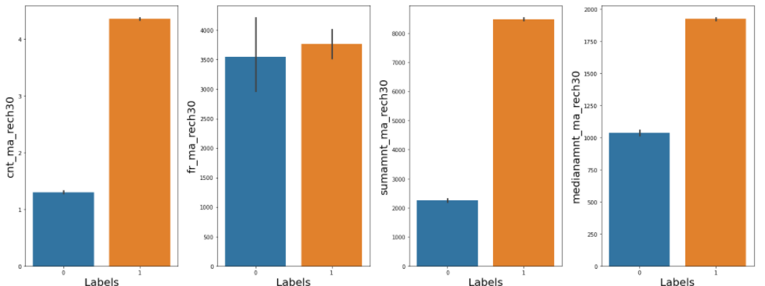
Defaulter has recharge maximum 1-2 times while others user recharges their credit for more than 4 times in a month.
Defaulters has total amount of recharge in main account over last 30 days maximum in range 2200 -2300 while other users recharged their main account with summation more than 8000.
Defaulters has median amount of recharge in main account over last 30 days maximum in range 100 -1050 while other users recharged their main account with summation more than 1900.
Median of main account balance just before recharge in last 30 days at user level (in Indonesian Rupiah) for defaulter maximum was more than 5000 while others having approximately 4000.

Slide 14
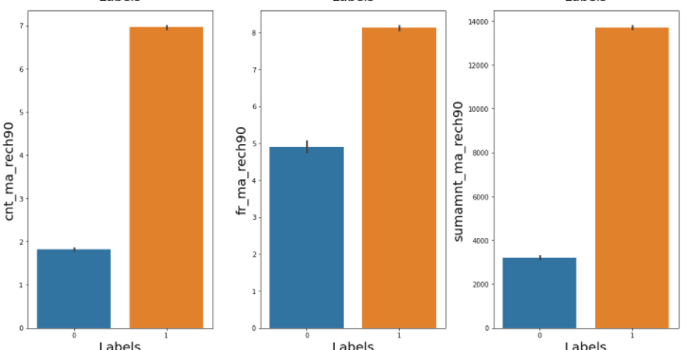
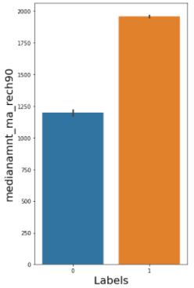
Defaulter has recharge maximum 1-2 no. of times main account got recharged in last 90 days while other users used more having 7 times.
Frequency of main account recharged in last 90 days for defaulter is maximum of 5 while other having of more than 8.
defaulters has total amount of recharge in main account over last 90 days maximum is less than 4000 while other users recharged their main account with summation approx. 14000.
defaulters has median amount of recharge in main account over last 90 days maximum in range 1200 -1250 while other users recharged their main account with summation more than 2000.

Slide 15
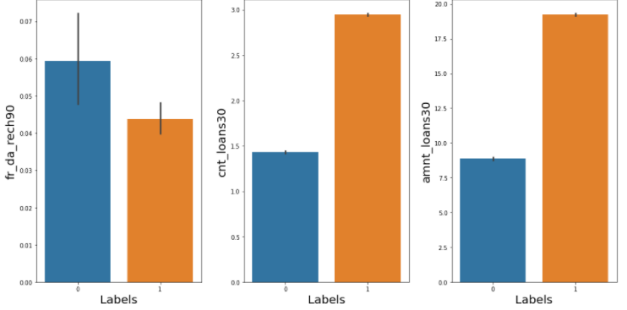
Frequency for data recharge over 90 days for defaulter is more than 0.07 while other users has approximately 0.05
Number of loans taken by defaulters in last 30 days was approximately 1.5 while other users has approximately 3.0
Total amount of loans taken by defaulter in last 30 days was approx. 9 while other users has approx. 20.

Slide 16
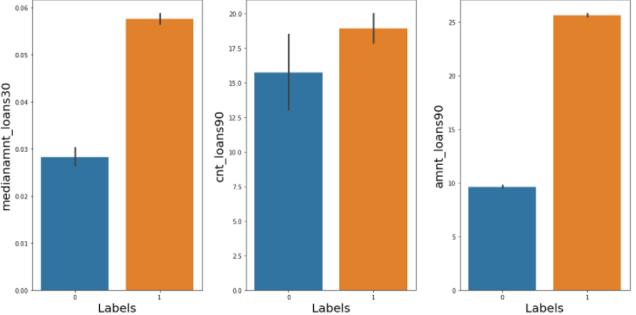
Median of amounts of loan taken by the defaulters in last 30 days was approx 0.03 while other users has approx. 0.06.
Number of loans taken by defaulters in last 30 days has max approx 17.5 while other users has max of approx. 20.0 .
Max total amount of loans taken by defaulters in last 30 days is of 10 while other users has taken more than 25.

Slide 17
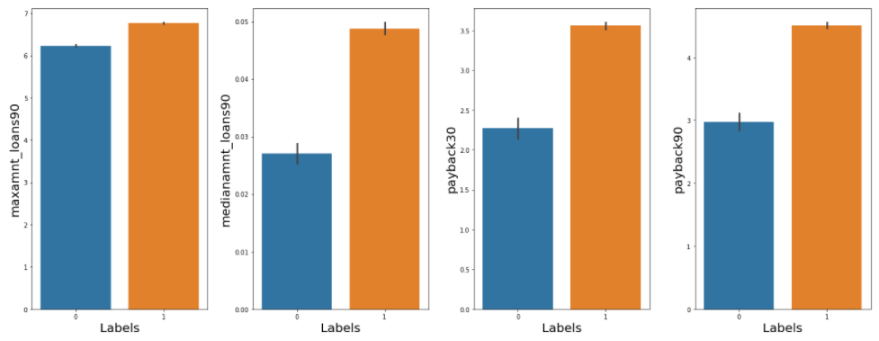
Max amount of loan taken by the defaulters is approx 6 while others has taken approx 6.6. over 90 days
Max median of amount taken by the defaulters is approx 0.03 while other users has taken approx 0.05 over 90 days.
payback by the defaulter is approx 2.5 while other users payback more than 3 over 30 days
payback by the defaulter is approx 3 while other users payback more than 4 over 90 days

Slide 18
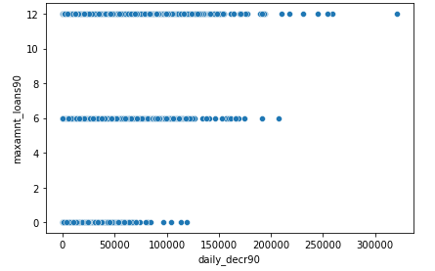
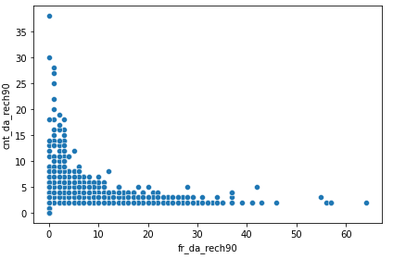
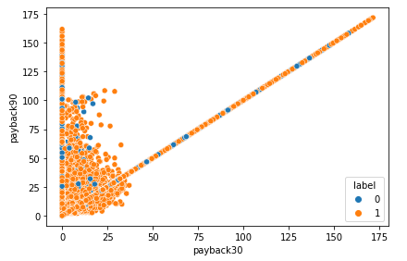
Here we can see that somehow the max_amnt_loan_over 90 days and daily amount spent over 90 are linear dependent.
Here we can see that Count of data recharge over 90 days increases w.r.t. decrease in frequency of data recharge over 90 days.
From average payback over 30 days is co-linear with the payback90

Slide 19
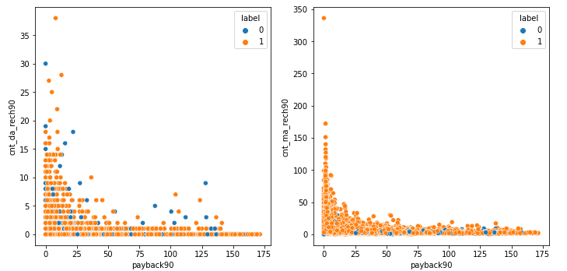
There seems some relation that the user pay backs their loans who had recharge less no. of time for their data account as well as their main account too.

Slide 20
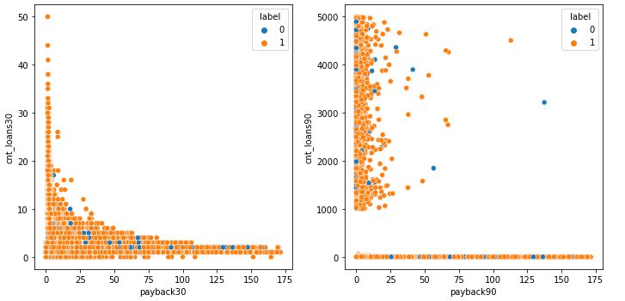
Over 30 days the user highlypay back their loan who has taken less no. of loan.
But over 90 days the user who has taken greater than 1000 times the loans has very rarely paybacks their loans this customer has benefits with the credit cad but there seems to be defaulter too.

Slide 21
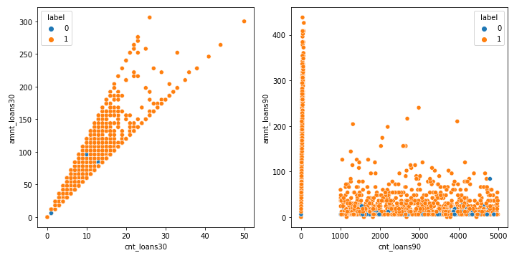
Over 30 days the user has higher amount of loans with respect to increase in the no. of times the loan taken but there is no such relation seems for over 90 days the most of user has overcome the amount of loan taken.

Slide 22
Steps taken to clean data:
Here I removed such columns that shouldn’t ne negative like
No. of days on a particular network,
Till last day of recharge amount for main and data account,
Daily spent of amount by the user.
And such records that user has more than 18000 days to keeps this means the user is keeping approx. 50 years that shouldn’t be practical possible for columns aon,last_rech_data_ma,last_rech_data_ma.
In statistical description of data the std is high using square root method we reduces the variance too.

Slide 23
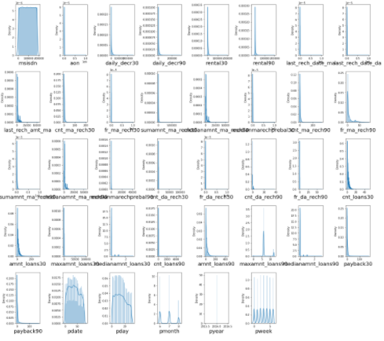
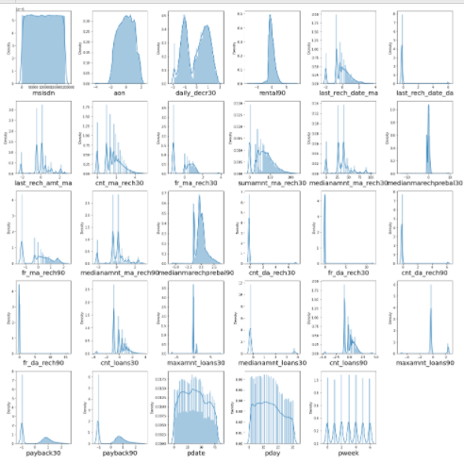
Distribution before cleaning and after cleaning with Power transformer technique we increased the distribution normally/ less skewed.

Slide 24
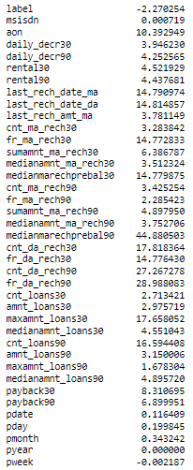
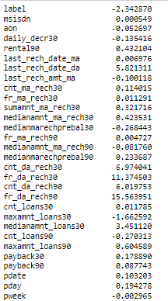
Data skewness before cleaning.
Data skewness after cleaning and used Power Transformer technique
Except columns that we transformed for categorical type attributes are in range of 0.5 to -0.5 while all others attributes are highly skewed.
So, we used Power Transformer technique with yeo-Johnson method due to which we reduced much skewness.

Slide 25
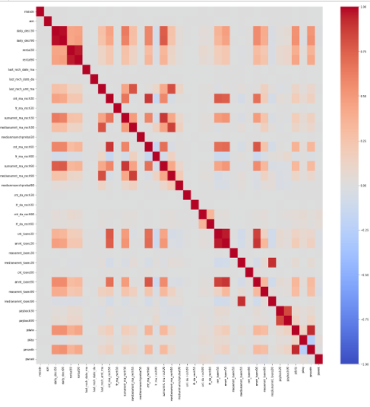
Dropping Columns
daily_decr30====daily_decr90
Rental30====rental90
cnt_ma_rech30====cnt_ma_rech90
sumamnt_ma_rech30====sumamnt_ma_rech90
cnt_loans30====amnt_loans30
cnt_loans30====amnt_loans90
amnt_loans30====amnt_loans90
medianamnt_loans30===medianamnt_loans90
Pdate===pmonth
These are features that are co-linear with each other of collinearity greater than 90%.
Removed such columns that has single like pyear and pcircle.

Slide 26
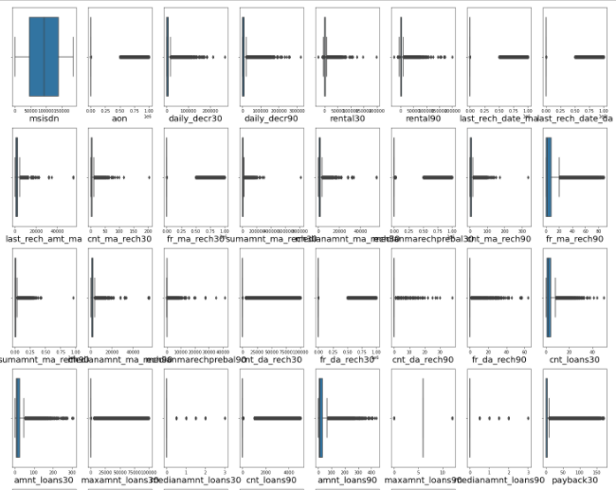
Outliers Detection
Looks like all columns has outliers but 'daily_decr30', 'last_rech_amt_ma','cnt_ma_rech30','sumamnt_ma_rech30', 'medianamnt_ma_rech30' , 'medianamnt_ma_rech90','medianmarechprebal90' these columns has such very less no. records that are not usual/continuous. While others columns are seems to be continuous.

Slide 27
Conditions that are considered for Data Cleaning & Transformed activities
Mobile numbers was object type using Label encoder to transform the Msisdn no. to a unique no. to each msisdn no..
Age or number of days are never negative which we removed or the days that are greater than 18000 too..
Amount spent cannot be negative hence that is being handled.
Last recharge date for data account as well as main account these two attributes consists negative values and also greater than 18000. So, we removed such columns.
Transformed pdate columns and also derive attributes like days , month, week day.
Removed such features due to which two features are colinear with more than 90% and also column pyear & pcircle that consists single values in it.

Slide 28
Model Deployment

Slide 29
Model Used:
Used 5 models that are:
Logistic Regression
Decision Tree Classifier
Random Forest Classifier
AdaBoost Classifier
Bagging Classifier

Slide 30
Before training or test the dataset steps we perform
Feature Selection: Used SelectKBest to select top 24 features.
Standardized the data using StandardScalar().
Balanced the dataset as the target variable was not balanced so we used SMOTE and did upsampling the data about 75%.

Slide 31
Accuracy of each model:
The highest accuracy is 76.4% of model Logistic Regression at random state 10.
The highest accuracy is 90.29% of model Decision Tree Classifier at random state 8.
The highest accuracy is 94.48% of model Random Forest Classifier at random state 8.
The highest accuracy is 86.79% of model AdaBoost Classifier at random state 8.
The highest accuracy is 93.22% of model Bagging Classifier at random state 10.

Slide 32
Best CV Score of each model:
Mean CV Score of model Logistic Regression:: 76.28 at k-fold::7
Mean CV Score of model Decision Tree Classifier :: 90.10 at k-fold::7
Mean CV Score of model Random Forest Classifier :: 94.54 at k-fold::7
Mean CV Score of model AdaBoost Classifier :: 86.2 4at k-fold::7
Mean CV Score of model Bagging Classifier :: 92.44 at k-fold::5

Slide 33
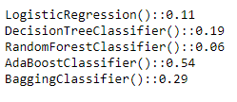
Finalized Model Selection
Least Difference between the CV Score and the accuracy is our final model.
Here for model Random Forest Classifier() we get the least value i.e. the difference between the accuracy and cv Score of this model is 0.06

Slide 34
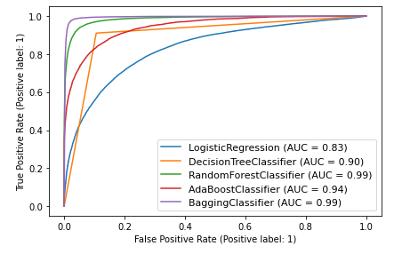
Plotting ROC Curve
The Bagging Classifier and Random Forest Classifier AUC score are same and we can see in plot. But we used Random Forest as this algorithm is faster than Bagging.

Slide 35
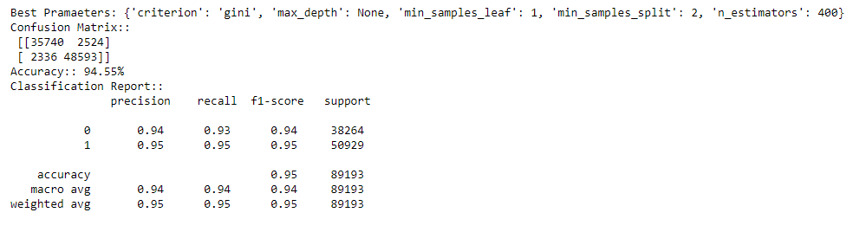
Hyper Parameter tuning.
Showing best parameters and accuracy, Confusion Matrix and Classification Report after Hyper tuning the Model.

Slide 36
THANK YOU!!

